Slide 1
 |  |  | श्री राधाकृष्णाभ्याम् नमः श्री गणेशायः नमः श्री सरस्वत्यै नमः
 |  |  | नमोनमः ((साबधान! A powerpoint that was highly and hugely criticised. Be cautious while reading it. We apologise for undigestable content.]
 |  |  | ॐ असतो मा सद्गमय । तमसो मा ज्योतिर्गमय । मृत्योर्मा अमृतं गमय । ॐ शान्तिः शान्तिः शान्तिः

Slide 2
 |  |  | ॐ तत् सत् ॐ तत् सत् ॐ तत् सत्
 |  |  | Topic & Presentator:
 |  |  | Part-I: Law, Religion & State in Western Context -Rupa Chalise -Khina Devi Dhakal -Ratish Kanta Jha -Shiva Prasad Acharya
 |  |  | सत्यम् शिवम् सुन्दरम्

Slide 3
 |  |  | ॐ तत् सत् ॐ तत् सत् ॐ तत् सत्
 |  |  | Introduction
 |  |  | Law, state and religion has always been one of the key topics of jurisprudential discussion. Jurisprudence has always been deeply reflecting the inter relationship between law, religion and state though the variables has always been shifting in terms of focal point. During early Middle Age religion had really an upper hand on jurisprudential discussion during renaissance state and law has always been foundation which interplayed with law and state. Though the leading face has always been changing but rest two has never left each other like shadows
 |  |  | सत्यम् शिवम् सुन्दरम्

Slide 4
 |  |  | ॐ तत् सत् ॐ तत् सत् ॐ तत् सत्
 |  |  | What is Law?
 |  |  | Few questions concerning human Society have been asked with such persistence and answered by serious thinkers in so many diverse, strange and even paradoxical ways as the question ‘what is law?’ H.L.A Hart This quote summarizes the whole interplay and attempt that has been made in order to answer ‘what is law?’ Nevertheless no complete answer has been ever achieved that satisfies all but nevertheless each thought has helped to explore the realm of law in human society
 |  |  | सत्यम् शिवम् सुन्दरम्

Slide 5
 |  |  | ॐ तत् सत् ॐ तत् सत् ॐ तत् सत्
 |  |  | What is State?-1
 |  |  | State is not that an absolute alien concept for us since we all live in state and have more or less our own particular understanding and explanation for it. However if we step a little bit forward and try to answer ‘what is state?’ dropping our own perception toward state than we may say state is a form of political association founded on legal fabric. Nevertheless many dimension of state shall not be incorporated in it.
 |  |  | सत्यम् शिवम् सुन्दरम्

Slide 6
 |  |  | ॐ तत् सत् ॐ तत् सत् ॐ तत् सत्
 |  |  | What is State? -2
 |  |  | Chandran Kukathas in his article “A Definition of the State” has pointed problem in defining state. They are First, the state is a form of association with a history, so the entity that is to be described is one that has evolved or developed and, thus, cannot readily be captured in a snapshot. Second, the concept of the state itself has a history, so any invocation of the term will have to deal with the fact that it has been used in subtly different ways. .
 |  |  | सत्यम् शिवम् सुन्दरम्

Slide 7
 |  |  | ॐ तत् सत् ॐ तत् सत् ॐ तत् सत्
 |  |  | What is State? -3
 |  |  | Third, not all the entities that claim to be, or are recognized as, states are the same kinds of entity, since they vary in size, longevity, power, political organization and legitimacy. Fourth, because the state is a political entity, any account of it must deploy normative concepts – such as legitimacy – that are themselves as contentious as the notion of the state. Although the state is not uniquely difficult to define, these problems need to be acknowledged, he states.
 |  |  | सत्यम् शिवम् सुन्दरम्

Slide 8
 |  |  | ॐ तत् सत् ॐ तत् सत् ॐ तत् सत्
 |  |  | What is Religion?-1
 |  |  | It is really difficult to explain religion because it is Janus faced one facing to deity and other follower. If we explore religion from perspective of deity it turn out be sacred book and if we explore religion from perspective of followers it deeply invites psychological realm, coinciding religion into belief. Explanation on religion is distinct if we go through Occidental and Oriental version
 |  |  | सत्यम् शिवम् सुन्दरम्

Slide 9
 |  |  | ॐ तत् सत् ॐ तत् सत् ॐ तत् सत्
 |  |  | What is Religion?-2
 |  |  | “A religion is a unified system of beliefs and practices relative to sacred things, that is to say, things set apart and forbidden – beliefs and practices which unite into one single moral community called a Church, all those who adhere to them." (b) [Religion is] "the self-validation of a society by means of myth and ritual." (Émile Durkeim, The Elementary Forms of the Religious Life) . "Religion, like culture, is a symbolic transformation of experience." (Thomas F. O'Dea,The Sociology of religion)
 |  |  | सत्यम् शिवम् सुन्दरम्

Slide 10
 |  |  | ॐ तत् सत् ॐ तत् सत् ॐ तत् सत्
 |  |  | What is Religion?-3
 |  |  | According to Aurobindo Ghose- “the quest of man for god is the foundation for religion and its essential function is the search for god and the finding of god”. (The Life Devine) According to J. Krishnamurti “What we call religion is merely organized belief, with its dogmas, rituals, mysteries and superstitions
 |  |  | सत्यम् शिवम् सुन्दरम्

Slide 11
 |  |  | ॐ तत् सत् ॐ तत् सत् ॐ तत् सत्
 |  |  | Interrelationship between Law, State and Religion in Context of Natural law School:
 |  |  | Discussing about interrelationship between law, state and religion in pretext of natural law than it is not same throughout. It’s been layers and layers since Greeks to present context with many turns.
 |  |  | सत्यम् शिवम् सुन्दरम्

Slide 12
 |  |  | ॐ तत् सत् ॐ तत् सत् ॐ तत् सत्
 |  |  | Greek Civilization-1
 |  |  | The story of natural law begins with the philosophers of ancient Greece and its true meaning is still a matter of controversy today. The most diverse elements are gathered under the same label-Greek philosophy and medieval rationalism, Roman law and Christian theology, actual custom and moral intuition . Paton Greek civilization the foremost civilization(in terms of proven history), aimed to figure out many mysteries, answer many question looking at face of mankind and civilization and which came up with many answer in diverse field has been genesis of various discipline and knowledges.
 |  |  | सत्यम् शिवम् सुन्दरम्

Slide 13
 |  |  | ॐ तत् सत् ॐ तत् सत् ॐ तत् सत्
 |  |  | Greek Civilization-2
 |  |  | In context of Greeks interrelationship between law, state and religion is unique. The Greeks had no word for religion itself; the nearest terms were Eusebia (“piety”) and Threskeia (“cult”) . The most-striking characteristic of Greek religion was the belief in a multiplicity of anthropomorphic deities under one supreme god. Priests simply looked after cults; they did not constitute a clergy, and there were no sacred books.
 |  |  | सत्यम् शिवम् सुन्दरम्

Slide 14
 |  |  | ॐ तत् सत् ॐ तत् सत् ॐ तत् सत्
 |  |  | Greek Civilization-3
 |  |  | The sole requirements for the Greeks were to believe that the gods existed and to perform ritual and sacrifice, through which the gods received their due. To deny the existence of a deity was to risk reprisals, from the deity or from other mortals . Since Greek religious practices didn’t constitute of any sacred books and norms and was limited to protection and security from gods on the basis of rituals and sacrifices they made, barely we can articulate religious influence on Law and state.
 |  |  | सत्यम् शिवम् सुन्दरम्

Slide 15
 |  |  | ॐ तत् सत् ॐ तत् सत् ॐ तत् सत्
 |  |  | Greek Civilization-4
 |  |  | Instead of projecting themselves into the sphere of religion like the people of India and Judea, instead of taking this world on trust and seeing it by faith, the Greeks took their stand in the realm of thought and daring to wonder about things visible, they attempted to conceive of the universe in light of reason . Earnest Barker. MDA Freeman states that the Greeks were the earliest to have a conception of Natural Law principles.
 |  |  | सत्यम् शिवम् सुन्दरम्

Slide 16
 |  |  | ॐ तत् सत् ॐ तत् सत् ॐ तत् सत्
 |  |  | Greek Civilization-5
 |  |  | According to Friedman the frequent change in laws of Greek city states was the factor which triggered Sophist to ponder upon law and where they reached to the conclusion that the natural law was different and distinct from written law. Sophist strongly believed law as tool created by the strong and the mighty to promote their own advantage which they found correct.
 |  |  | सत्यम् शिवम् सुन्दरम्

Slide 17
 |  |  | ॐ तत् सत् ॐ तत् सत् ॐ तत् सत्
 |  |  | Greek Civilization-6
 |  |  | According to Friedman the frequent change in laws of Greek city states was the factor which triggered Sophist to ponder upon law and where they reached to the conclusion that the natural law was different and distinct from written law. Sophist strongly believed law as tool created by the strong and the mighty to promote their own advantage which they found correct
 |  |  | सत्यम् शिवम् सुन्दरम्

Slide 18
 |  |  | ॐ तत् सत् ॐ तत् सत् ॐ तत् सत्
 |  |  | Greek Civilization-7
 |  |  | Socrates and his disciple stated that law was miscalculated by Sophist and such notion of law can cause more chaos in society than harmony. Thus they forwarded concept of just along with law. Aristotle further forwarded source of law that is human reasoning which was unalterable and same though out and Aristotle thus laid down the foundation of a significant qualitative change in the content of Greek philosophy: a change from abstraction to concreteness, from radical arguments to a state of balance in the idea of Law and Justice
 |  |  | सत्यम् शिवम् सुन्दरम्

Slide 19
 |  |  | ॐ तत् सत् ॐ तत् सत् ॐ तत् सत्
 |  |  | Greek Civilization-8
 |  |  | Stoics following reasoning of Aristotle submerged religion with god. Nature was no more pattern of event and now nature was declared element which ruled each human heart and no Greek state and people were beyond nature
 |  |  | सत्यम् शिवम् सुन्दरम्

Slide 20
 |  |  | ॐ तत् सत् ॐ तत् सत् ॐ तत् सत्
 |  |  | Greek Civilization-9
 |  |  | In context of state practices according to Britannica the origin of city-states is disputed. On the other hand there was no uniform state governance rather governance varied from Greek city states to states. However Greek Scholars ideas used to be respected and considered in Greek states. Thus we can say that Greek was in its tender, humble but yet promising beginning in dimension of Law, state and religion. In context of the interconnection between law state and religion in Greek than state and law was interrelated to some extent whereas religion didn’t have that greater influence since religion didn’t impart any moral values rather it was limited in ritual and sacrifices.
 |  |  | सत्यम् शिवम् सुन्दरम्

Slide 21
 |  |  | ॐ तत् सत् ॐ तत् सत् ॐ तत् सत्
 |  |  | Roman Civilization
 |  |  | Romans who were the inhabitants of the Italian peninsula from ancient times until the ascendancy of Christianity in the 4th century AD, unlike the Greeks, who excelled in intellectual and artistic endeavors, achieved greatness in their military, political, and social institutions
 |  |  | सत्यम् शिवम् सुन्दरम्

Slide 22
 |  |  | ॐ तत् सत् ॐ तत् सत् ॐ तत् सत्
 |  |  | Roman State System-1
 |  |  | The state system of Rome can be studied by broadly categorizing it into two Roman Republic and Roman Empire. Romans overthrew their Etruscan conquerors in 509 B.C.E., the Etruscans who had ruled over the Romans for hundreds of years. Once they were free, the Romans established republic, a government in which citizens elected representatives to rule on their behalf.
 |  |  | सत्यम् शिवम् सुन्दरम्

Slide 23
 |  |  | ॐ तत् सत् ॐ तत् सत् ॐ तत् सत्
 |  |  | Roman State System-2
 |  |  | The Senate which already existed to advice king became most powerful governing body once king was overthrown and instead of appointing new head of the state Senate elected the chief executives, called Consuls. Two Consuls used to be elected by the people in the Comitia Centuriata (a popular assembly) annually. Two Consuls had veto power over one another and were head of armies . Occasionally, when an emergency situation (such as a war) arose that required the decisive leadership of one individual. Under these circumstances, the Senate and the consuls could appoint a temporary dictator to rule for a limited time until the crisis was resolved . (The other key institution of Roman Republic was the army. The Romans had a paid professional army where soldiers had to put in a minimum of 25 years of service. )
 |  |  | सत्यम् शिवम् सुन्दरम्

Slide 24
 |  |  | ॐ तत् सत् ॐ तत् सत् ॐ तत् सत्
 |  |  | Roman Empire
 |  |  | Roman Empire began with Augustus first Roman Emperor. He was founder of Roman Principate i.e. first phase of Roman Empire. Although Augustus was the sole ruler and the only real source of authority, the fiction was kept alive that he was actually only the ‘leading citizen’, not the absolute ruler The first two century of Roman Empire was Peaceful and prosperous but while arriving at third century there was major internal strain and fighting on several fronts though Roman Empire had increased number of Senator including Plebian in Senate.
 |  |  | सत्यम् शिवम् सुन्दरम्

Slide 25
 |  |  | ॐ तत् सत् ॐ तत् सत् ॐ तत् सत्
 |  |  | Roman Religion:
 |  |  | Romans much similar to those of Greek had religious practices which basically comprised of sacrifices and rituals. Though Roman stoics really believed in god however Roman religion was based not on divine grace but instead on mutual trust (fides) between god and man . Much similar to Greeks Roman mythology didn’t comprised of any moral sets to guide human life . But with arrival of Christianity in Rome with crucifixion of Jesus beginning for religious influence on law and sate was embarked in history of Europe
 |  |  | सत्यम् शिवम् सुन्दरम्

Slide 26
 |  |  | ॐ तत् सत् ॐ तत् सत् ॐ तत् सत्
 |  |  | Roman Religion:
 |  |  | Romans much similar to those of Greek had religious practices which basically comprised of sacrifices and rituals. Though Roman stoics really believed in god however Roman religion was based not on divine grace but instead on mutual trust (fides) between god and man . Much similar to Greeks Roman mythology didn’t comprised of any moral sets to guide human life . But with arrival of Christianity in Rome with crucifixion of Jesus beginning for religious influence on law and sate was embarked in history of Europe
 |  |  | सत्यम् शिवम् सुन्दरम्

Slide 27
 |  |  | ॐ तत् सत् ॐ तत् सत् ॐ तत् सत्
 |  |  | Religion in Rome Post Crucifixion
 |  |  | With arrival of Christianity there was huge tables turn in context of religion and its influence on law and state in Rome For several years Rome attempted to suppress Christianity and wished her citizen to embrace Roman deities over Christianity. During the 3rd century, economic collapse, political chaos, military revolt, and barbarian invasion nearly destroyed the Roman Empire. Christians were blamed for the desperate situation because they denied the gods who were thought to protect Rome, thereby bringing down their wrath. To regain divine protection, the emperors introduced the systematic persecution of Christians throughout the empire . From 303 to 311A.D. Christianity faced worst persecution in Rome under the co-emperors Diocletian and Galerius
 |  |  | सत्यम् शिवम् सुन्दरम्

Slide 28
 |  |  | ॐ तत् सत् ॐ तत् सत् ॐ तत् सत्
 |  |  | Religion in Rome Post Crucifixion -2
 |  |  | The situation of the early church improved further the following year, when the emperor Constantine, In 313 the joint emperors Constantine and Licinius issued the Edict with this Christianity was embraced in Roman Empire Emperor Theodosius I (reigned 379–395), made Catholic Christianity the official religion of the empire By the end of the 4th century, Christianity had been transformed from a persecuted sect to the dominant faith of the empire, in the process becoming intertwined with the imperial government The close relations between the empire and the church in the 4th century are reflected in the writings of St. Ambrose (bishop of Milan, 374–397), who used “Roman” and “Christian” almost as synonyms. The stronger Church institution became in Rome more influence was created over public and state in area of religious faith and moral behavior.
 |  |  | सत्यम् शिवम् सुन्दरम्

Slide 29
 |  |  | ॐ तत् सत् ॐ तत् सत् ॐ तत् सत्
 |  |  | Roman Law
 |  |  | Roman law developed really well in time frame of Roman Republics. In earlier days though, we can find two forms of laws being recognized law (jus) and divine law (fas) in Rome. The earliest law of Rome was twelve tables written by 10 commissioners (decemvirs) at the insistence of the plebeians, who felt their legal rights, were hampered by the fact that court judgments were rendered according to unwritten custom preserved only within a small group of learned patricians The twelve tables were prepared in 451-450 B.C., and were ratified by the Centuriate Assembly in 449 B.C . The code contained principally private law, but it also shows some sacred law as well as public and criminal statutes.
 |  |  | सत्यम् शिवम् सुन्दरम्

Slide 30
 |  |  | ॐ तत् सत् ॐ तत् सत् ॐ तत् सत्
 |  |  | Roman Law-2
 |  |  | Gaius furthered the idea that every system of positive law can be divided into two parts: some rules are changeable because they depend on men’s wills, other are universally accepted and immutable since they depend on reason. Praetor Peregrinus (who administers justice among foreigners) forwarded Jus Gentium to deal with foreigner since rule of Jus civile was not applicable to foreigner Thus Roman really mastered on application of law for state and society. Forwarding question for future as Paton states what is the permanent underlying basis of law ?
 |  |  | सत्यम् शिवम् सुन्दरम्

Slide 31
 |  |  | ॐ तत् सत् ॐ तत् सत् ॐ तत् सत्
 |  |  | Interrelationship between Law, State and Religion
 |  |  | Discussing about interrelationship between law, state and religion during Romans until arrival of Christianity religion had no influence over state and law. Law was greatly utilized by romans in state administration, where law was outcome of philosophical quest and observation not based on religious values. Presence of Christianity deeply influenced both state and law of Rome. Christian Fathers handed over morality to the Roman society which not only influenced Rome but also other part of Europe due to philosophical element present in it according to Arthur Cushman Mcgiffer
 |  |  | सत्यम् शिवम् सुन्दरम्

Slide 32
 |  |  | ॐ तत् सत् ॐ तत् सत् ॐ तत् सत्
 |  |  | Dark Age-1
 |  |  | United Rome was equally divided by Theodosius among his two sons, Arcadius(E) and Honorius;(w) Due to own internal strain and attack from multiple frontiers especially by Germanic tribe Western Rome Empire collapsed and the very causalities of war caused Dark Age in West Rome followed by plague Whereas the term 'Dark Ages' was coined by an Italian scholar named Francesco Petrarch. Petrarch, who lived from 1304 to 1374 Fall of Roman Empire in West caused situation of uncertainty until West Rome was not taken over by Charlemagne and his ancestor.
 |  |  | सत्यम् शिवम् सुन्दरम्

Slide 33
 |  |  | ॐ तत् सत् ॐ तत् सत् ॐ तत् सत्
 |  |  | Dark Age-2
 |  |  | State system of West Rome is more popularly known as Holy Roman Empire. "The Holy Roman Empire was in no way holy, nor Roman, nor an empire," Volatire Charlemagne who was already ruler of wide territory was for the first time crowned King of Rome by Pope Leo III in 800 A.D. since fall of Roman Empire which was a great honor and with this step formal inter-relation between state and religion was embarked . As the result presence of Pope was more dominating in Western Rome comparison to Byzantine.
 |  |  | सत्यम् शिवम् सुन्दरम्

Slide 34
 |  |  | ॐ तत् सत् ॐ तत् सत् ॐ तत् सत्
 |  |  | Dark Age-3
 |  |  | The recognition of Holy Roman empire by Pope and recognition of Pope as highest religious authority in western Rome gave birth to so called two sword and Europe witnessed the tug of war between Church and Emperor for Long run unless age of Renaissance. Don Fanning writes that with the endorsement of the Emperor and obligatory church membership for all Roman citizens across the empire, Roman Christianity continued to change the nature of the Church, instead of visa versa. The humble beginnings were soon forgotten in the luxurious halls and civil power of the highest courts and assemblies of the known world. Who needs spiritual power when you can have civil power? While Fanning further writes that during Dark Age Church were both externally struggling for universal acceptance as an authority figure in a divided empire, while internally arguing for how to define what the Church believes
 |  |  | सत्यम् शिवम् सुन्दरम्

Slide 35
 |  |  | ॐ तत् सत् ॐ तत् सत् ॐ तत् सत्
 |  |  | Byzantine Empire
 |  |  | In context of state practice byzantine empire was continuing Roman Empire legacy. In context of religion, religious institution and bishops didn’t had any upper hand unlike Holy Roman empire. In context of Law byzantine Empire has made really huge contribution in history of Western legal system because in Byzantine Empire Justinian code was developed by Emperor Justinian I Further St. Augustine, St. Thomas Aquinas and other Christian fathers really played important role in articulating Christian theology with Greek and Roman scholars.
 |  |  | सत्यम् शिवम् सुन्दरम्

Slide 36
 |  |  | ॐ तत् सत् ॐ तत् सत् ॐ तत् सत्
 |  |  | Renaissance
 |  |  | The Renaissance was a cultural movement that began in Italy in the 14th century, and spread to the rest of Europe. The Renaissance was a period in Europe, from the 14th to the 17th century, regarded as the cultural bridge between the Middle Ages and modern history. Number of event took place during latter half of Middle Age which caused Renaissance Age. It is said that this age made people realize that “Man is the measure of all things” which was forgotten while mankind was too much involved with religion. Renaissance age didn’t made any sudden shift to existing social state but did explored and questioned each existence and pattern developed around self rather that taking it for granted from Christian theology and age old work In words of Paton “In Middle Ages we find the germ of theories that later became of great practical importance.
 |  |  | सत्यम् शिवम् सुन्दरम्

Slide 37
 |  |  | ॐ तत् सत् ॐ तत् सत् ॐ तत् सत्
 |  |  | Law, Religion and State in present Context:
 |  |  | Law, state and religion in Europe In his book “The Still born God” Mark Lilla attempt to elucidate the philosophical efforts of European thinkers to overcome and move beyond the mental, political, and social boundaries of Christianity and claims that religious madness propitiated the rise of the German Third Reich. Further authors such as Taylor and Casanova agree that up to the 15th century all areas of European life were dominated by religion and by Western Christianity in particular. However, beginning in the late 15th century, Europe embarked on a long process of secularization or what Taylor calls “disenchantment” which led to a decline in religious influence over political and ultimately, personal, life that has few parallels elsewhere in the world. Weber and Durkheim both attributed major importance to the emergence of capitalism and saw religious decline as an inevitable by-product of modernity
 |  |  | सत्यम् शिवम् सुन्दरम्

Slide 38
 |  |  | ॐ तत् सत् ॐ तत् सत् ॐ तत् सत्
 |  |  | Ronan McCrea “Religion and the Public Order of the European Union Religion”
 |  |  | In a 2006 address to the European People’s Party, Pope Benedict XVI stated that: "As far as the Catholic Church is concerned, the principal focus of her interventions in the public arena is the protection and promotion of the dignity of the person, and she is thereby consciously drawing particular attention to principles which are not negotiable”. As to the specific areas of policy related to the dignity of the person, the Pope mentioned three areas upon which the church had focused:
 |  |  | सत्यम् शिवम् सुन्दरम्

Slide 39
 |  |  | ॐ तत् सत् ॐ तत् सत् ॐ तत् सत्
 |  |  | Ronan McCrea “Religion and the Public Order of the European Union Religion”-2
 |  |  | -protection of life in all its stages, from the first moment of conception until natural death; - recognition and promotion of the natural structure of the family - as a union between a man and a woman based on marriage - and its defense from attempts to make it juridical equivalent to radically different forms of union which in reality harm it and contribute to its destabilization, obscuring its particular character and its irreplaceable social role; - the protection of the right of parents to educate their children”
 |  |  | सत्यम् शिवम् सुन्दरम्

Slide 40
 |  |  | ॐ तत् सत् ॐ तत् सत् ॐ तत् सत्
 |  |  | Ronan McCrea “Religion and the Public Order of the European Union Religion” -3
 |  |  | Further Article 11(2) of the Lisbon Treaty commits the Union to maintaining an “an open, transparent and regular dialogue with representative associations and Civil Society” Article 17 singles out religious bodies and specifically undertakes to maintain a dialogue with them. The Article, which also incorporates the 1998 Declaration on the Status of Churches, reads :
 |  |  | सत्यम् शिवम् सुन्दरम्

Slide 41
 |  |  | ॐ तत् सत् ॐ तत् सत् ॐ तत् सत्
 |  |  | Ronan McCrea “Religion and the Public Order of the European Union Religion” -3
 |  |  | The Union respects and does not prejudice the status under national law of churches and religious associations or communities in the Member States. 2. The Union equally respects the status under national law of philosophical and non-confessional organizations. 3. Recognizing their identity and their specific contribution, the Union shall maintain an open, transparent and regular dialogue with these churches and organizations.
 |  |  | सत्यम् शिवम् सुन्दरम्

Slide 42
 |  |  | ॐ तत् सत् ॐ तत् सत् ॐ तत् सत्
 |  |  | Ronan McCrea “Religion and the Public Order of the European Union Religion” -4
 |  |  | Commission President Jacques Delors made this point explicitly in an address to the “Soul for Europe” initiative in which he stated that: “We won't succeed with Europe solely on the basis of legal expertise or economic know-how....If in the next ten years we have not managed to give a soul to Europe, to give it spirituality and meaning, the game will be up” Further, Part I §4 of the Danish Constitution states “The Evangelical Lutheran Church shall be the Established Church of Denmark, and as such shall be supported by the State”. Part II §6 of the Constitution also lays down a requirement that the monarch “be a member of the Evangelical Lutheran Church” In Finland, the Evangelical Lutheran Church is also established by law. Article 3 of the Greek Constitution recognizes the Greek Orthodox Church as “the prevailing religion in Greece”. Other faiths are generally treated as private associations
 |  |  | सत्यम् शिवम् सुन्दरम्

Slide 43
 |  |  | ॐ तत् सत् ॐ तत् सत् ॐ तत् सत्
 |  |  | Law state and religion in North America
 |  |  | America which gave world concept and practice of written constitution, which is integral part of modern state system has served world in its own way in multiple layers. Discussing about position of America in context of Law, state and religion than though, America being a highly religious country, whose currency read “In God We Trust”, holds quiet strict separation between State, law and religion. American Constitution 1787 in Article 6 reads "no religious test shall ever be required as a Qualification to any Office or public Trust under the United States" . Further first amendment of the Bill of Rights contains two clauses that prescribe the government's relationship with religion. In the first instance, the Establishment Clause states that "Congress shall make no law respecting an establishment of religion." The second clause of the First Amendment states “Congress shall make no law .
 |  |  | सत्यम् शिवम् सुन्दरम्

Slide 44
 |  |  | ॐ तत् सत् ॐ तत् सत् ॐ तत् सत्
 |  |  | Topic & Presentator:
 |  |  | Part-II: Law, Religion & State in Oriental Context (with Overall Conclusion of Part-I & II) -Rupa Chalise -Khina Devi Dhakal -Ratish Kanta Jha -Shiva Prasad Acharya
 |  |  | सत्यम् शिवम् सुन्दरम्

Slide 45
 |  |  | ॐ तत् सत् ॐ तत् सत् ॐ तत् सत्
 |  |  | धर्मक्षेत्रे कुरूक्षेत्रे समवेता युयुत्सवः। मामकाः पाण्डवाश्चैव किमकुर्वत सञ्जय।१। - भगवद्गीता प्रथम अध्याया प्रथम श्लोक .
 |  |  | सत्यम् शिवम् सुन्दरम्

Slide 46
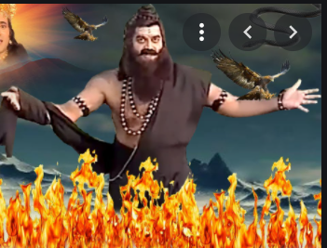
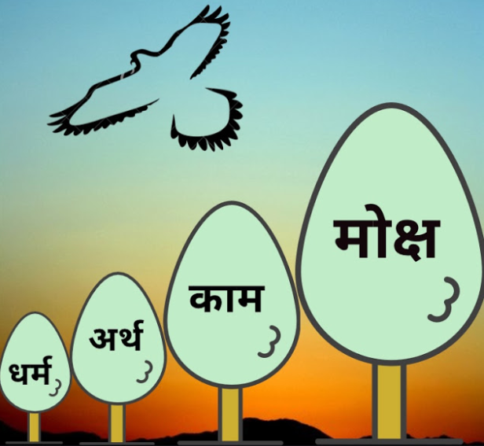
 |  |  | ॐ तत् सत् ॐ तत् सत् ॐ तत् सत्
 |  |  | धर्मार्थकाममूलहिरमृतंमोक्षप्रदं यतः -शुक्रनीति (१।५)
 |  |  | .
 |  |  | Meaning: I pay my humble obeisance to the state which is the source of Dharma, Artha, Kama and Moksya
 |  |  | सत्यम् शिवम् सुन्दरम्

Slide 47
 |  |  | ॐ तत् सत् ॐ तत् सत् ॐ तत् सत्
 |  |  | 1.18
 |  |  | धर्मा बहुविधा लोके श्रुतिभेदमुखोद्बवाः । देशधर्माश्च दृश्यन्ते कुलधर्मास्तथैव च ॥ जातिधर्मा वयोधर्मा गुणधर्माश्च शोभने । शरीर-कालधर्माश्च आपद्धर्मास्तथैव च ॥ एतद्धर्मस्य नानात्वं क्रियते लोकवासिभिः। -परासरधर्मसंहिता १।१७
 |  |  | सत्यम् शिवम् सुन्दरम्

Slide 48
 |  |  | ॐ तत् सत् ॐ तत् सत् ॐ तत् सत्
 |  |  | 1.18
 |  |  | धर्मा बहुविधा लोके श्रुतिभेदमुखोद्बवाः । देशधर्माश्च दृश्यन्ते कुलधर्मास्तथैव च ॥ जातिधर्मा वयोधर्मा गुणधर्माश्च शोभने । शरीर-कालधर्माश्च आपद्धर्मास्तथैव च ॥ एतद्धर्मस्य नानात्वं क्रियते लोकवासिभिः। -परासरधर्मसंहिता १।१७
 |  |  | सत्यम् शिवम् सुन्दरम्

Slide 49
 |  |  | ॐ तत् सत् ॐ तत् सत् ॐ तत् सत्
 |  |  | Secularism views
 |  |  | Secularism does not mean irreligion or atheism. It lays stress on universality of spiritual values which may be attained by a variety of ways. -Dr. Sarvapalli Radhakrishnan Secularism does not accept anything which makes difference between man and man. Humanist based on reason, not religious dogmas, is the salient feature of secularism -Indian writer R.L. Chaudhary
 |  |  | सत्यम् शिवम् सुन्दरम्

Slide 50
 |  |  | ॐ तत् सत् ॐ तत् सत् ॐ तत् सत्
 |  |  | Constitutional Provision:
 |  |  | Article:3 Article:4 Articl:9 Article: 26 ‘RELIGION’ word has been used for 21 times ‘RELIGIOUS’ word for 16 times and ‘SECULAR’ word has been used only 2 times in our constitution.
 |  |  | सत्यम् शिवम् सुन्दरम्

Slide 51

 |  |  | ॐ तत् सत् ॐ तत् सत् ॐ तत् सत्
 |  |  | 1.11
 |  |  | Wooden iron = secular culture/ secular state National Anthem: Schedule 1 of CON Article 9: Cow as National Animal Article 26: Right to freedom of Religion Burka religious practice is baned and homosexual marriage is established as new religious practice in France.
 |  |  | सत्यम् शिवम् सुन्दरम्

Slide 52

 |  |  | ॐ तत् सत् ॐ तत् सत् ॐ तत् सत्
 |  |  | 1.7 धमिरा: metaphor.
 |  |  | सत्यम् शिवम् सुन्दरम्

Slide 53
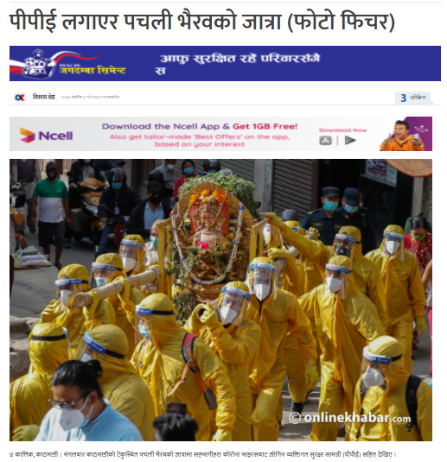
 |  |  | ॐ तत् सत् ॐ तत् सत् ॐ तत् सत्
 |  |  | Freedom of Religion V. Freedom from Religion:
 |  |  | सत्यम् शिवम् सुन्दरम्

Slide 54
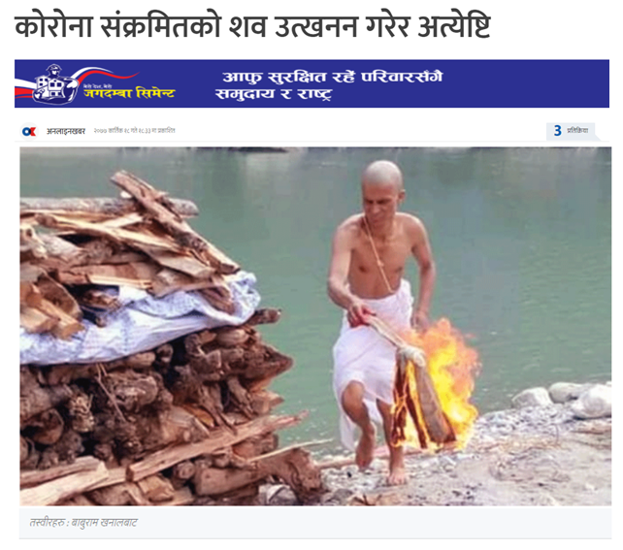
 |  |  | ॐ तत् सत् ॐ तत् सत् ॐ तत् सत्
 |  |  | Freedom of Religion Vs. Freedom from Religion
 |  |  | सत्यम् शिवम् सुन्दरम्

Slide 55
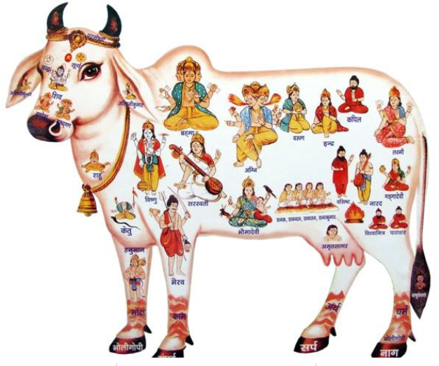
 |  |  | ॐ तत् सत् ॐ तत् सत् ॐ तत् सत्
 |  |  | Freedom of Religion Vs. Freedom from Religion
 |  |  | सत्यम् शिवम् सुन्दरम्

Slide 56
 |  |  | ॐ तत् सत् ॐ तत् सत् ॐ तत् सत्
 |  |  | 1.19
 |  |  | Nepal is a secular country. Secularism means State neutrality in the matters of religion, it means there is no official or sponsored religion of India like Shri Lanka, where Buddhism is official religion. Pakistan is having Islam as a national religion. The de Juri status of Nepal is that Nepal is Secular State. However, de facto Nepal seems to be Hindu State. Ex. Sonia Ghandhi Pasupati visit issue.
 |  |  | सत्यम् शिवम् सुन्दरम्

Slide 57
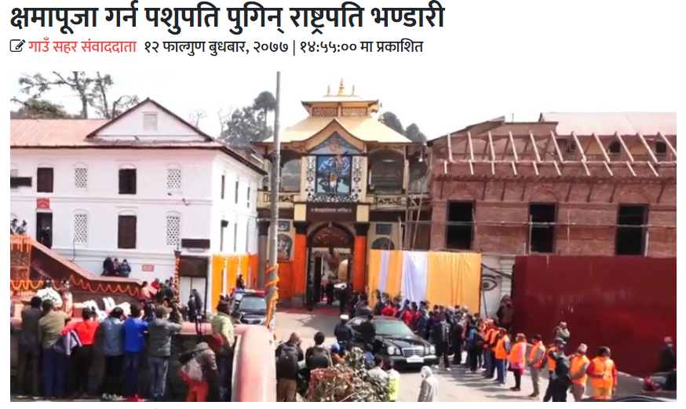
 |  |  | ॐ तत् सत् ॐ तत् सत् ॐ तत् सत्
 |  |  | Theory and Practice of Secularism-1
 |  |  | सत्यम् शिवम् सुन्दरम्

Slide 58
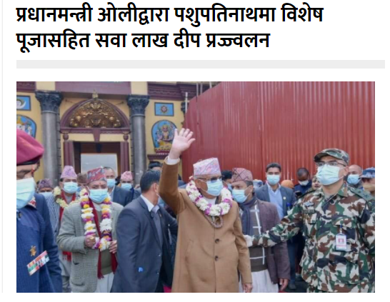
 |  |  | ॐ तत् सत् ॐ तत् सत् ॐ तत् सत्
 |  |  | Theory and Practice of Secularism-2
 |  |  | सत्यम् शिवम् सुन्दरम्

Slide 59
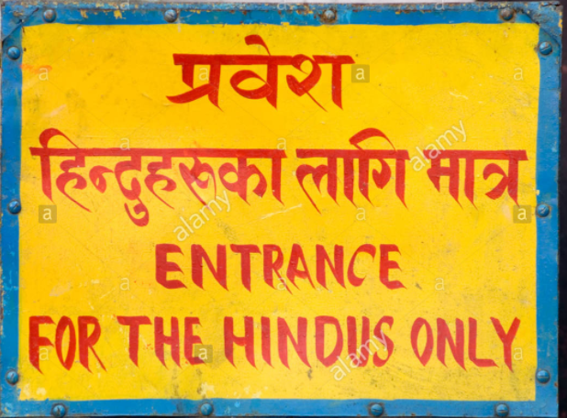
 |  |  | ॐ तत् सत् ॐ तत् सत् ॐ तत् सत्
 |  |  | Thoery and practice of Secularism-3
 |  |  | सत्यम् शिवम् सुन्दरम्

Slide 60
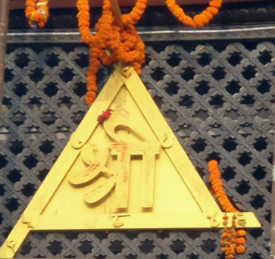
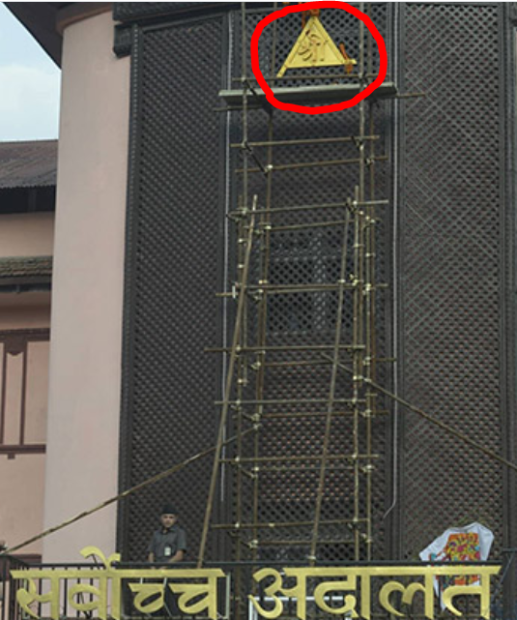
 |  |  | ॐ तत् सत् ॐ तत् सत् ॐ तत् सत्
 |  |  | Theory and Practice of Secularism-4
 |  |  | सत्यम् शिवम् सुन्दरम्

Slide 61
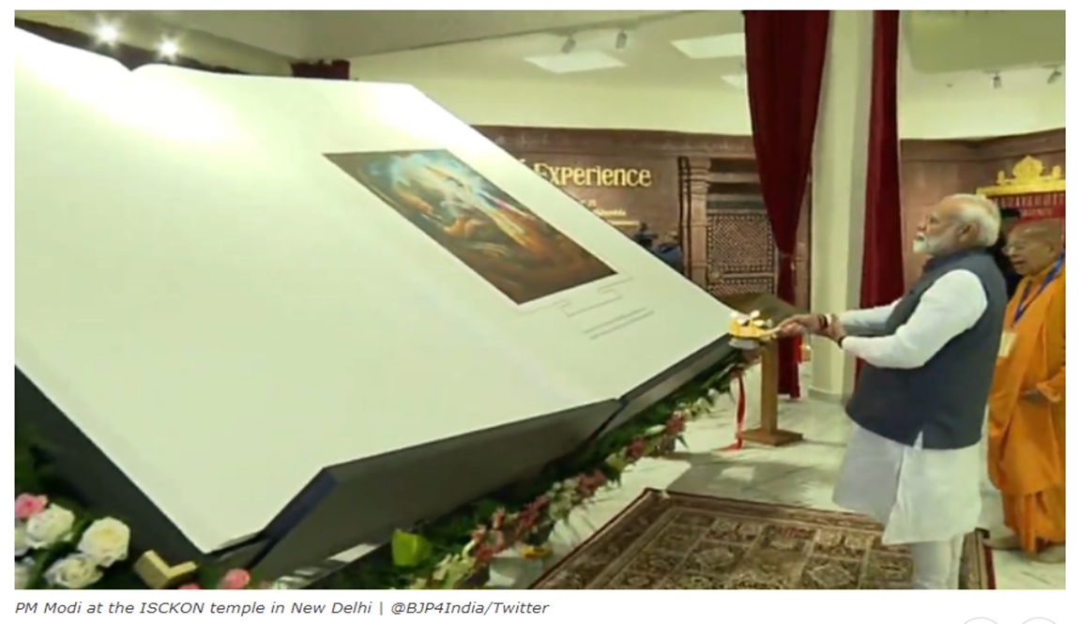
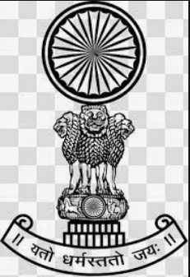
 |  |  | ॐ तत् सत् ॐ तत् सत् ॐ तत् सत्
 |  |  | Theory and practice of Secularism-5
 |  |  | सत्यम् शिवम् सुन्दरम्

Slide 62
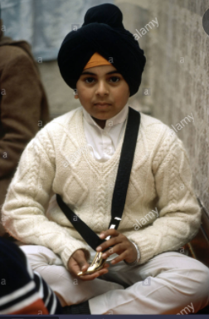
 |  |  | ॐ तत् सत् ॐ तत् सत् ॐ तत् सत्
 |  |  | Canadian Case: Multani Case
 |  |  | Multani v. Commission scolaire Marguerite-Bourgeoys A school child in Canada wore kirpan (sword) being a Sikh in school premise. The school governing board eventually found that wearing a kirpan on school premise would violate the school code of conduct's prohibition on weapons. The student parent file case in Canadian Supreme Court. Quebec's Attorney General intervened, issuing a statement emphasizing a zero-tolerance policy for "knives" in school, including kirpans. In Multani v. Commission scolaire Marguerite-Bourgeoys , the Supreme Court of Canada held that an orthodox Sikh student could wear a kirpan ( a sword), a ceremonial dagger, to school given his strong religious beliefs. Baptized Sikhs, like the Multanis, believe in five symbols of faith (the Five K's) including a comb (kangha), a pair of britches (kachha), a bracelet (karha), a head turban to cover uncut hair (keski), and a sword (kirpan). Sikhs view the kirpan as a religious symbol to be worn at all times rather than a weapon. The court noted "a total prohibition against wearing a kirpan to school undermines the value of this religious symbol.
 |  |  | सत्यम् शिवम् सुन्दरम्

Slide 63
 |  |  | ॐ तत् सत् ॐ तत् सत् ॐ तत् सत्
 |  |  | 1.27: Japanese Cases: Municipal Funding in ceromony:
 |  |  | Case: I: Suenaga v. Tsu-City [Japan, 1960] Fact of the case: A groundbreaking-ceremony of a Tsu-City municipal gymnasium (“Groundbreaking Ceremony”) hosted by Tsu municipal government took place in a Shinto-style. The case was filed claiming that the funding by municipal is against the Art. 20 of Japanese constitution. Decision of SC: The Groundbreaking Ceremony does not apply to the violation of Art.20 of the Constitution. Ratio: Principle of the separation of a state and any particular religion means that a state should remain religiously neutral. This does not mean, however, non-permissibility for a state to have any ties with a religion, but rather, it is to limit having such religious connection between the state and a religion where the purpose and effect of a state’s religious activity is in excessive levels in relation to the principal aim of the principle, the constitutional guarantee of the freedom of religion in light of social and cultural background of the nation.
 |  |  | सत्यम् शिवम् सुन्दरम्

Slide 64
 |  |  | ॐ तत् सत् ॐ तत् सत् ॐ तत् सत्
 |  |  | 1.27: Japanese Cases: Parent’s Day on Sunday
 |  |  | Case 2: Sawa v. Koiwa Elementary School [Japan, 1982] FACTS: Plaintiffs were the two students of Koiwa Elementary School at Edogawa-ku. On a school’s parents’ day (held on Sunday) , they attended their regular church instead of going to the school. This was recorded as “absence” on their students’ record cards as well as the school’s evaluation record.. ISSUE: Does parents’ day scheduled for Sunday at public elementary schools infringe Christians’ freedom of religion? Decision: The Tokyo District Court dismissed the claims. Ratio: The parents’ day on Sunday is in accordance with the School Education Acts and it is procedurally legal to make students who did not participate in the parents’ day absent. The disadvantage to the plaintiffs are within the range of tolerate and there was no abuse of its authority by the principal.
 |  |  | सत्यम् शिवम् सुन्दरम्

Slide 65
 |  |  | ॐ तत् सत् ॐ तत् सत् ॐ तत् सत्
 |  |  | Indian Cases
 |  |  | Case: Acharya Jagadishwaran and Avadhuta Vs. Commissioner of police Calcutta, AIR 1984 SC 51. In 1955, Shri Pravat Rajan Sarkar, known as Shri Ananda Murti, founded a socio- spiritual organization to dedicate to the service of huminity in different spheres of life such as physical, mental, and spiritual, irrespective of caste creed or colour. In 1966 Ananda Murti introduced a Tandava dance – is to be performed with a skull, a small knife and a trisul. This tended to disturb public peace, tranquility, and public order, which led to prosecution of AnandaMurti and his followers.
 |  |  | सत्यम् शिवम् सुन्दरम्

Slide 66
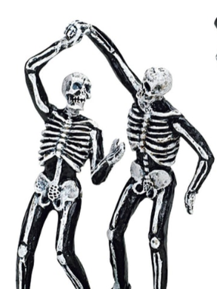
 |  |  | ॐ तत् सत् ॐ तत् सत् ॐ तत् सत्
 |  |  | Indian Cases: Ananda Margi Tandava Dance
 |  |  | The contention of petitioner was that Tandave Dance was an essential part of religious rites of AnandaMargi and they are entitled to practice these rites. The Supreme Court held that the Tandav dance at public place by AnandaMargi carrying weapons and human skulls was not an essential religious rite. So, Section 144 of CrPc prohibiting such procession in the interest of public order and morality was not violative of the fundamental rights of petitioners under Article 25 and 26 of Indian Constitution.
 |  |  | सत्यम् शिवम् सुन्दरम्

Slide 67
 |  |  | ॐ तत् सत् ॐ तत् सत् ॐ तत् सत्
 |  |  | Indian Cases
 |  |  | Case II Mohd. Hanif Qureshi Vs. State of Bihar,(AIR 1958 SC 731) The petitioners challenged the State Act concerning prohibiting cow slaughter, arguing that such Bill violated their freedom of religion guaranteed under Article 25 of the constitution, since it was customary practice of Muslim community to sacrifice cows on Baker-id day. The petitioner also complained that the said Act violated their fundamental right to personal liberty under Article 19 (1)(g) of the constitution. Upon the examination of relevant versions mentioned in Koran and Hidaya, the court found that it was optional for a Muslim to sacrifice a goat for one person or a cow or camel for seven members. The court observed that the Muslim religious texts did not make it obligatory to sacrifice a cow on this Baker-id. So the court held that there was no infringement of religious freedom in the total ban on caw slaughter.
 |  |  | सत्यम् शिवम् सुन्दरम्

Slide 68
 |  |  | ॐ तत् सत् ॐ तत् सत् ॐ तत् सत्
 |  |  | Indian Cases: National Anthem Case
 |  |  | Case 3: Bijoe Emmanual Vs. State of Kerala,( AIR 1986 SC 615) Three children refused to sing the national anthem as per to them it was against the tenets of their “Jehova” religious faith which did not permit them to join in any rituals except if it be in their prayer to jehova their god. Keral High Court held that it was their fundamental duty under the constitution to sing the national anthem. On the appeal two judges of Supreme Court reversed the High Court decision and held that there is no legal obligation in India for a citizen to sing national anthem.
 |  |  | सत्यम् शिवम् सुन्दरम्

Slide 69
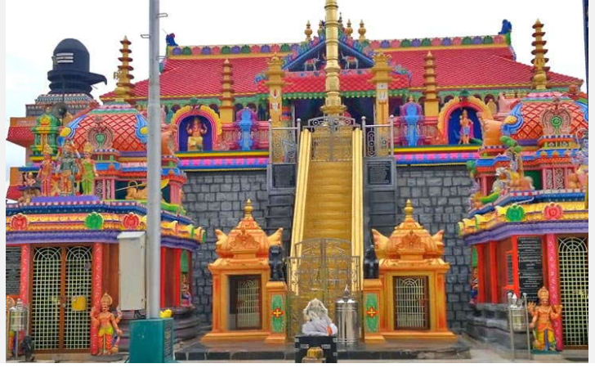
 |  |  | ॐ तत् सत् ॐ तत् सत् ॐ तत् सत्
 |  |  | Sa
 |  |  | Indian Case: Sabarimala Temple Issue
 |  |  | सत्यम् शिवम् सुन्दरम्

Slide 70
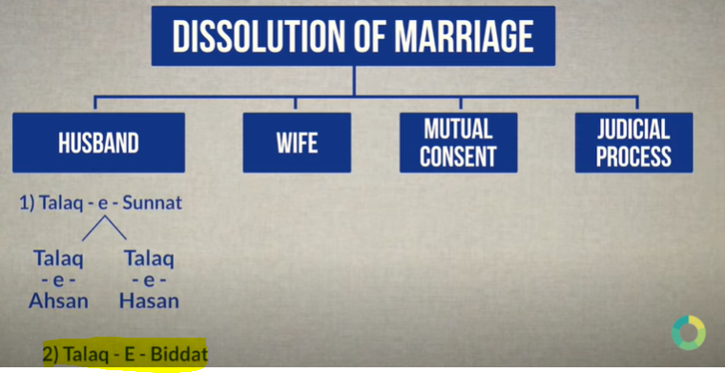
 |  |  | ॐ तत् सत् ॐ तत् सत् ॐ तत् सत्
 |  |  | Indian Case: Triple Talak
 |  |  | सत्यम् शिवम् सुन्दरम्

Slide 71
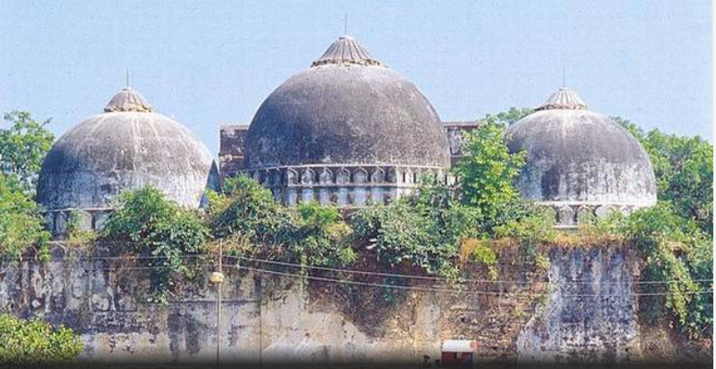
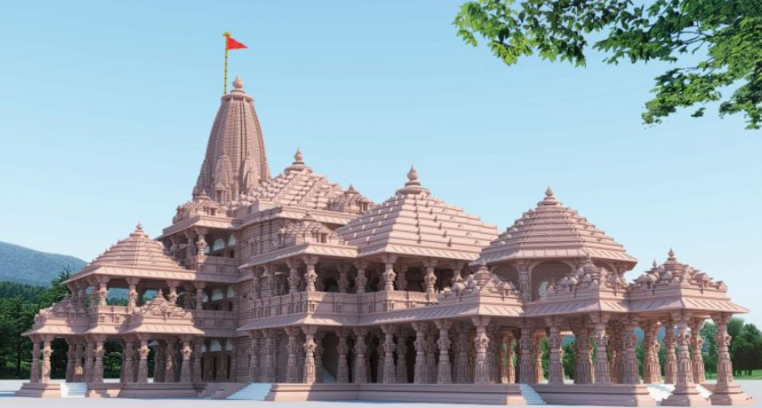
 |  |  | ॐ तत् सत् ॐ तत् सत् ॐ तत् सत्
 |  |  | Indian Case: Ramjanmabhumi Dispute
 |  |  | सत्यम् शिवम् सुन्दरम्

Slide 72
 |  |  | ॐ तत् सत् ॐ तत् सत् ॐ तत् सत्
 |  |  | सर्वोच्च अदालतद्वारा करिव ३ वर्ष अगाडि नै प्रतिपादन गरेको सिद्धान्तले आज परिपूर्णता प्राप्त गरेको महसुस भयो।
 |  |  | सान्त्वना सुवेदी वि. काठमाडौं उपत्यका विकास प्राधिकरण (नि.नं. १०१०२, प्रकरण नं. १०) यो "धर्मो रक्षति रक्षितः" भने जस्तै कुरा हो। विधिको रक्षा गर्‍यो भने मात्र हाम्रो रक्षा हुन्छ। (प्रसङ्गः प्रधानमन्त्रिले संविधानको रक्षा नगर्नाले संविधानले उनको रक्षा गर्न सकेन।)
 |  |  | सत्यम् शिवम् सुन्दरम्

Slide 73
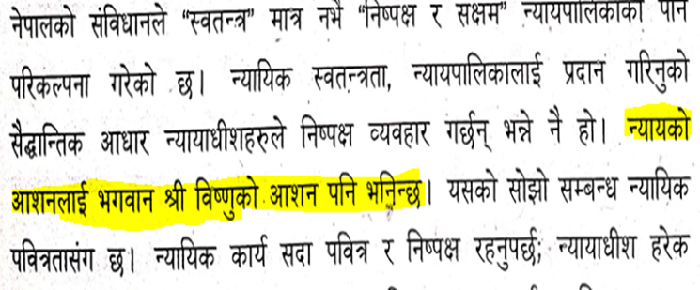
 |  |  | ॐ तत् सत् ॐ तत् सत् ॐ तत् सत्
 |  |  | Ananda M. Bhattarai and Deepak K. Karki’s Separate Opinion:
 |  |  | सत्यम् शिवम् सुन्दरम्

Slide 74
 |  |  | ॐ तत् सत् ॐ तत् सत् ॐ तत् सत्
 |  |  | Snehas Care Vs. OPMC (D.No. 10299)
 |  |  | गाई संवैधानिक रूपमा हाम्रो राष्ट्रिय पहिचानसँग जोडिएको विषय मात्र नभई हाम्रो धर्म, संस्कृति, सभ्यता र परम्पराको एक प्रतीक हुँदा गौरक्षा नेपालको एउटा राष्ट्रिय दायित्व हुने।
 |  |  | सत्यम् शिवम् सुन्दरम्

Slide 75
 |  |  | ॐ तत् सत् ॐ तत् सत् ॐ तत् सत्
 |  |  | Charibahadhur Gagatraj Vs. OPMCM (D.No. 8707)
 |  |  | धर्मनिरपेक्ष राज्यमा सरकार वा सरकारका निकायहरू धर्मबाट पृथक रहनु पर्छ भन्ने मानिन्छ । तर, यसको अर्थ ऐतिहासिक तथा धार्मिक महत्वका स्थानको संरक्षणमा सरकारको प्रशासकीय जिम्मेवारी हुने। धर्मनिरपेक्षता भनेको राज्यको धर्ममा अहस्तक्षेपकारी भूमिका कायम राख्दै राज्यमा बस्ने विभिन्न धर्मावलम्बीहरूको धर्मलाई समान रुपले सम्मान दिनुपर्छ भन्ने मान्यता मात्र हो । एउटा धार्मिक आस्थामा अर्को धर्मको अतिक्रमण रोक्नु धर्म निरपेक्षता नै हो धर्म सापेक्षता हुन नसक्ने ।
 |  |  | सत्यम् शिवम् सुन्दरम्

Slide 76
 |  |  | ॐ तत् सत् ॐ तत् सत् ॐ तत् सत्
 |  |  | Conclusion:
 |  |  | Conclusions (Part I & II)
 |  |  | सत्यम् शिवम् सुन्दरम्

Slide 77
 |  |  | ॐ तत् सत् ॐ तत् सत् ॐ तत् सत्
 |  |  | Conclusion:-1
 |  |  | Larry Shiner has drawn up five concept of secularism: Decline of religion: The previously accepted symbols, doctrines and institutions lose their prestige and influence. Conformity with “this world” Turning away from the supernatural. Shift from faith to reason. Disengagement of society from religion: Society and state strive to constitute themselves as an autonomous reality or separation of religion and politics. Transposition of religious beliefs and institutions: Behavior and institutional arrangement once understood ‘as grounded in divine power are transformed into phenomena of purely human creation
 |  |  | सत्यम् शिवम् सुन्दरम्

Slide 78
 |  |  | ॐ तत् सत् ॐ तत् सत् ॐ तत् सत्
 |  |  | Conclusion-2
 |  |  | 4. Transposition of religious beliefs and institutions: Behavior and institutional arrangement once understood ‘as grounded in divine power are transformed into phenomena of purely human creation. 5.DDe-sacralisation of the world: Banishment of “sacred” or “mysterious”& welcoming of rationally manipulated society.esacralisation of the world: Banishment of “sacred” or “mysterious”& welcoming
 |  |  | सत्यम् शिवम् सुन्दरम्

Slide 79
 |  |  | ॐ तत् सत् ॐ तत् सत् ॐ तत् सत्
 |  |  | Conclusion-3
 |  |  | On the one hand, law gives religion its structure-the order and orthodoxy that it needs to survive and to flourish in society. Legal "habits of the heart" structure the inner spiritual life and discipline of religious believers, from the reclusive hermit to the aggressive zealot. Legal ideas of justice, order, atonement, restitution, responsibility & obligation pervade the theological doctrines of many religious traditions. Legal structures and processes-the Halacha in Judaism, the canon law in Christianity, the Shari'a in Islam-define and govern religious communities and their distinctive beliefs and rituals, mores and morals.
 |  |  | सत्यम् शिवम् सुन्दरम्

Slide 80
 |  |  | ॐ तत् सत् ॐ तत् सत् ॐ तत् सत्
 |  |  | Conclusion-4
 |  |  | On the other hand, religion gives law its spirit-the sanctity and authority it needs to command obedience and respect. Religion inspires the rituals of the court room, the decorum of the legislature, the pageantry of the executive office, all of which aim to celebrate and confirm the truth and justice of the law.47 Religion gives law its structural fairness, its "inner morality," as Lon Fuller called it. Legal rules and sanctions, just like divine laws and promises, are publicly proclaimed, popularly known, uniform, stable, understandable, prospectively applied, consistently enforced. Religion gives law its respect for tradition, for the continuity of institutions, language, and practice, for precedent and preservation.
 |  |  | सत्यम् शिवम् सुन्दरम्

Slide 81
 |  |  | ॐ तत् सत् ॐ तत् सत् ॐ तत् सत्
 |  |  | Conclusion-5
 |  |  | Religion gives law its authority and legitimacy, by inducing in citizens and subjects a reverence for law and structures of authority. Like religion, law has written or spoken sources, texts or oracles, which are considered to be decisive in themselves. Religion has the Bible and the Torah and the pastors and rabbis who expound them. Law has the constitutions and the statutes and the judges and agencies that apply them.
 |  |  | सत्यम् शिवम् सुन्दरम्

Slide 82
 |  |  | ॐ तत् सत् ॐ तत् सत् ॐ तत् सत्
 |  |  | 1.22 Conclusion-5
 |  |  | Law and religion, therefore, are two great interlocking systems of values and belief. They have their own sources and structures of normativity and authority, their own methods and measures of enforcement and amendment, their own rituals and habits of conceptualization and celebration of values. These spheres and sciences of law and religion exist in dialectical harmony. They share many elements, many concepts, and many methods. They also balance each other by counterpoising justice and mercy, rule and equity, orthodoxy and liberty, discipline and love. Without law, religion decays into shallow spiritualism. Without religion, law decays into empty formalism.
 |  |  | सत्यम् शिवम् सुन्दरम्

Slide 83
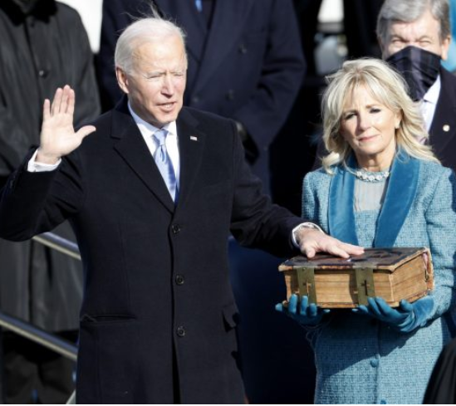
 |  |  | ॐ तत् सत् ॐ तत् सत् ॐ तत् सत्
 |  |  | Types of Secularism:
 |  |  | सत्यम् शिवम् सुन्दरम्

Slide 84
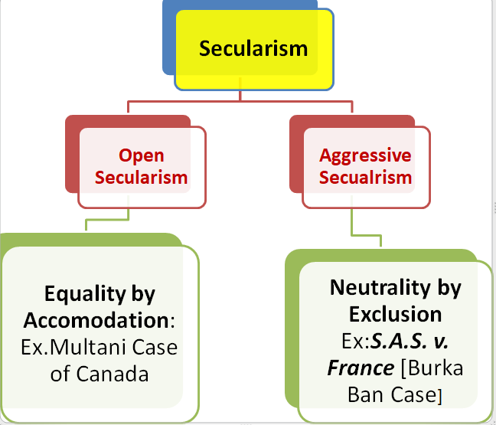
 |  |  | ॐ तत् सत् ॐ तत् सत् ॐ तत् सत्
 |  |  | Types of Secularism:
 |  |  | सत्यम् शिवम् सुन्दरम्

Slide 85
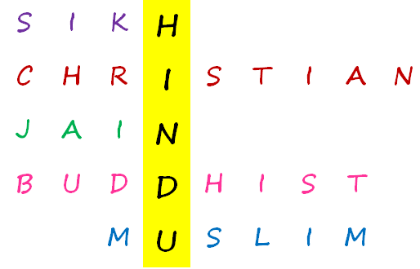
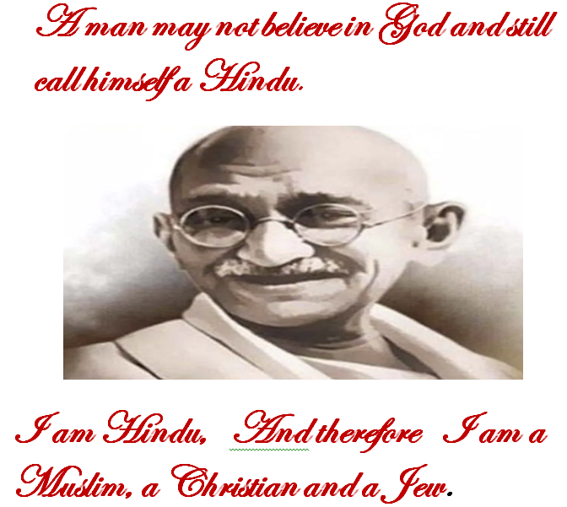
 |  |  | ॐ तत् सत् ॐ तत् सत् ॐ तत् सत्
 |  |  | Hinduism is a secular religion in itself.
 |  |  | Note: If one points out his finger to show the moon, one ought to look at the moon not his finger so as to catch the essence of his words.
 |  |  | सत्यम् शिवम् सुन्दरम्

Slide 86
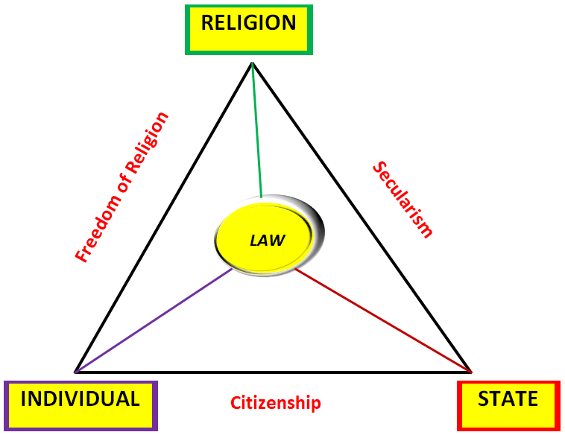
 |  |  | ॐ तत् सत् ॐ तत् सत् ॐ तत् सत्
 |  |  | Relationship between Law, Religion and State:
 |  |  | सत्यम् शिवम् सुन्दरम्

Slide 87
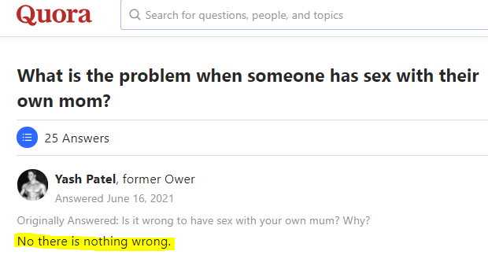
 |  |  | ॐ तत् सत् ॐ तत् सत् ॐ तत् सत्
 |  |  | Religion supercedes law and State:
 |  |  | Religion is not only about ritual, spiritual and salvation. Religion is much more than this. Its essence cannot be contemplated through our limited intelligence. Religion serves such a higher purpose which law and state fails to serve. Human being can exist without law and state but cannot live without religion. One can be irreligious but in true speaking it is itself a religion-IRRELIGIOUS RELIGION. सबको ज्ञान भया।
 |  |  | सत्यम् शिवम् सुन्दरम्

Slide 88
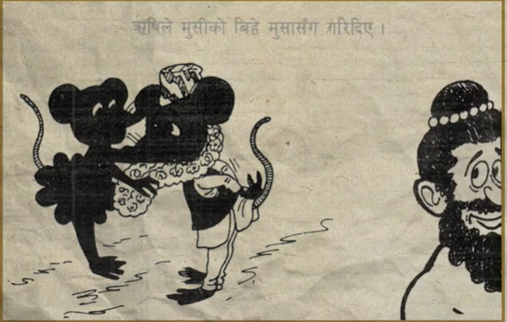
 |  |  | ॐ तत् सत् ॐ तत् सत् ॐ तत् सत्
 |  |  | Final Conclusion:
 |  |  | सत्यम् शिवम् सुन्दरम्

Slide 89
 |  |  | ॐ तत् सत् ॐ तत् सत् ॐ तत् सत्
 |  |  | धन्यवादः
 |  |  | सत्यम् शिवम् सुन्दरम्

